Slide 1
Transportation & Parking Committee
October 15, 2018

Slide 2
Committee Resources
Meeting Schedule
Updates
Future Topics

Slide 3
Committee Resources
Committee Web Site (Membership,Meeting Notes):
http://parking.virginia.edu/transportation-and-parking-committee-notes-and-membership
Appointment letters will be coming soon from the Senior VP for Operations
Charge - Make recommendation to the Senior VP for Operations (Colette Sheehy)
Meeting Notes - Available at web site above shortly after meetings

Slide 4
Meeting Schedule
Once per month during academic session
Joint meetings with General Safety and Security:
Twice-Annual Night Tours
November 5, 2018 at 7PM
Spring and Regular Meeting TBD

Slide 5
P&T Updates
New P&T Web site – http://parking.virginia.edu/
UTS – New Bus Stop Signs, Route Names, Purple Route Alignment
Transloc Issues
Parking & Transportation Study
Event Impacts for Inauguration (Oct 19) and Friday Football Game (11/2)
Brandon Avenue Construction Impacts
Scott Stadium Re-designation for Health System Commuters
Mopeds at Metered Parking
Technology Changes at Emmet/Ivy Garage and Central Grounds Garage
Park Connect and Mega-Bus
Electric Scooter Share

Slide 6
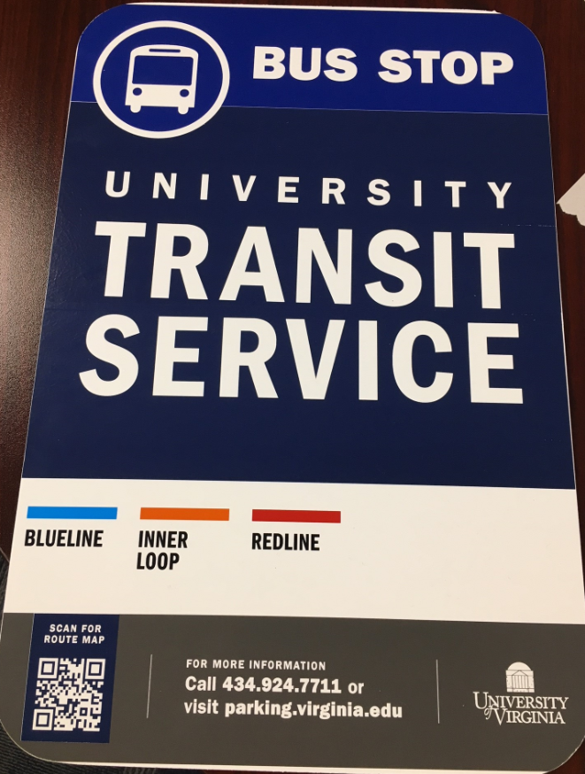
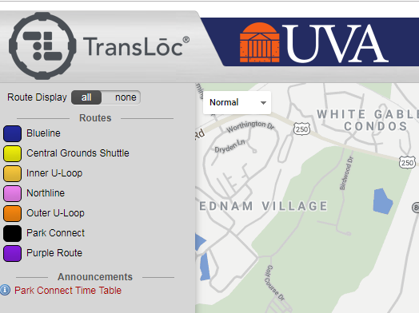
UTS Updates
Transloc has been sporadically providing inaccurate bus predictions.

Slide 7
Parking Study
Steering Committee
On-Line Comment Portal – 600+ responses
Focus Group and Open House Meetings – 100+ Participants
Draft Findings by Year End

Slide 8
Inauguration, Football
Inauguration:
http://inauguration.virginia.edu/general-information/parking-and-shuttle-buses
Football:
Friday, November 2, 2018, 7:30PM:
Parking & UTS impacts
Lot Vacate Time 4PM or 5PM
Parking Alternatives – EIG, JPJ
UTS Modification

Slide 9
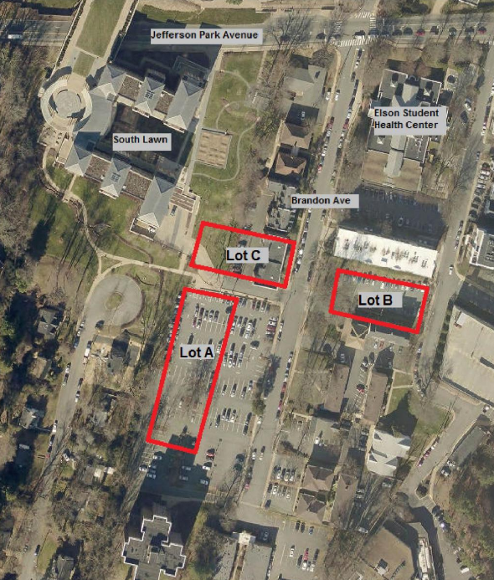
Brandon Construction
http://parking.virginia.edu/brandon-avenue-update-through-december-2018http://www.officearchitect.virginia.edu/pdfs/BrandonAveMasterPlan.pdfB
230 permit holders impacted
100 permit holders parking on-site (gravel) Completion of Brandon Housing moves those 100
into structure parking
Completion of Student Health moves most permit holders
back into structured parking

Slide 10
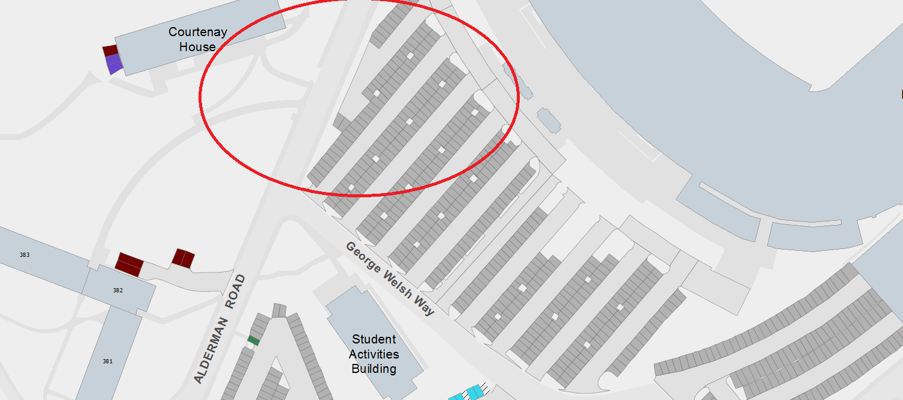
Updates Continued
Scott Stadium Re-Designation for Health System Commuters
Mopeds Now Required to Pay in Metered Parking Areas
Shift to Pay-by-Plate and Meters at Emmet/Ivy Garage and Central Grounds Garage (like Culbreth Road Garage)

Slide 11
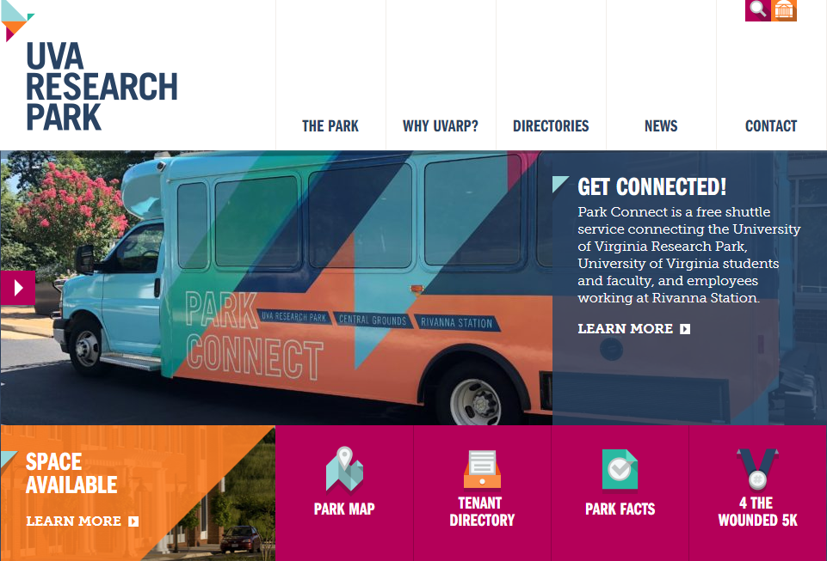
Park Connect, MegaBus
Park Connect
Mon-Fri, 7:30AM-6PM, 30-minute Service
Stops at Brandon and Health Science Library
MegaBus
Charlottesville Amtrak Station to WDC Union Station
2 trips on Sun, Mon, Thurs, Fri
1 trips on Tues, Weds, Sat
http://www.uvaresearchpark.com/why-uvarp/transportation/
https://us.megabus.com/

Slide 12
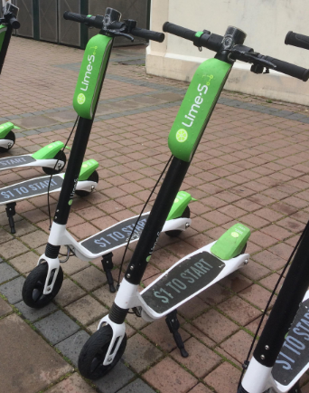
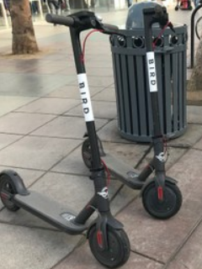
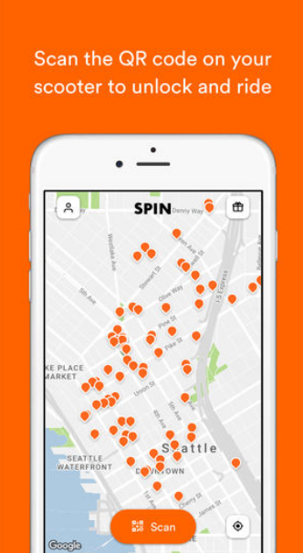
Electric Scooter Share
Several providers have shown interest in Charlottesville/UVA
UVA working with City to aligning approach (safety, operating norms)
Policy language pending (banned in UVA Housing)

Slide 13
Future Topics
Budget and Fees
Parking Study
Safety and Sustainability Initiatives
Regional Transportation Initiatives
Student Issues
Policy Recommendations
Other Issues

Slide 14
Discussion at 10/15/2018 Meeting
Aligning Employee ADA Parking on Health System and Academic Campus: A Subcommittee of Mark Stanis, Jess Wenger, and Becca will meet by the end of October to advance this goal.
Student Representation on T&P Committee: Becca will contact Ellen Yates, the student representation on the Parking Study Steering Committee, for potential student member.
Graduate Students being treated as students or employees: P&T will be working to change eligibility, payment, and parking permit renewal practices for graduate students to align with employee practices, not student practices.
McCormick Road Speed Limit Study: Helen Wilson, Gloria Graham, and Becca White will be meeting with a consultant by the end of October to possibly update multi-modal counts on McCormick Road between Physics Building and Chapel as a preliminary step for a possible speed warrant.

