Slide 1
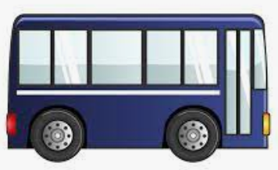
McCORMICK & WHITEHEAD SYNERGY
March 18, 2021

Slide 2
UTS Mission Statement
To provide safe, reliable, efficient, and friendly transit service to the University of Virginia students, faculty, staff, and visitors by emulating the “Three S’s” of transit.
Safety
Service
Schedule
Notes:
Safety: The most important S – this encompasses everything we do to ensure safe travel for our customers, others on the road, bikers, and pedestrians.
Service: Otherwise known as customer service. This includes a warm smile, friendly hello, knowledge of our service area, and reliability.
Schedule: Are buses on time? Do they run as frequently as needed? Do they meet the needs of our customers?

Slide 3
McCormick Rd Impact on UTS Mission
Safety – 86% of UTS accidents involving pedestrians/cyclists in the past 5 years occurred on McCormick Rd
BUT
Service – UTS service on McCormick Rd is convenient, creating good academic passenger relations
AND…
Notes:
*ALL UTS drivers involved in McCormick Rd pedestrian and cyclist accidents were found “not at fault”

Slide 4
McCormick Rd Impact on UTS Mission
Schedule – McCormick Rd creates bottleneck effect for routes, causing buses to run severely behind schedule
On-Time Performance of Academic Routes PreCOVID: ~80%
On-Time Performance of Academic Routes Current: ~93%
Which Affects…
Service, where reliability is important

Slide 5
McCormick & Whitehead Synergy
UTS can alter Operations to decrease bus traffic on McCormick – a.k.a. reduce McCormick Rd “Footprint”
UTS Modifications for Increased Transit Options on Whitehead
Additional bus and micromobility amenities
Reroute the UTS Green Line
Notes:
There are ways to access Central Grounds other than through McCormick Rd: Whitehead, Emmet Street, University Ave, JPA @ Cabell
One Way vs. Two Way: Ties into reducing the McCormick Rd footprint. 10 minute service → 12 Greens + 12 Golds each hour for bi-directional service vs 6 Greens + 6 Golds in Uni-directional service. One way traffic allows us to reduce our footprint by ~64%. Two-way traffic allows us to reduce footprint by ~27%. Recommendation for a one-way McCormick would be to travel from West to East (Trolley direction).
Conditional or Dynamic routes for McCormick: This is the idea of restricting bus traffic through McCormick during certain times of the day (i.e. class changes) or days of the week. This would allow UTS to turn on the McCormick valve during times that pedestrian traffic is lighter and bus traffic is less of a safety hazard.
No Routes: this would obviously decrease our McCormick Rd footprint the most, but may not be a viable option if vehicular traffic is not restricted off of McCormick.

Slide 6
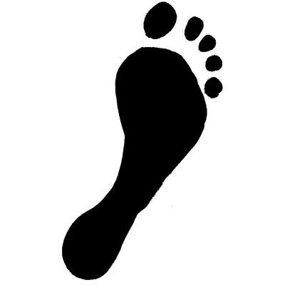
Reducing McCormick Rd Footprint
PreCOVID, UTS had 6 routes serving McCormick → 33 transit trips each hour
Reducing Footprint = Fewer Transit Trips
How?
Reduced routes on McCormick
Maintain current Orange Line and Silver Line routings
If McCormick is served, consider rerouting Gold Line and Green Line
Notes:
Reduced routes on McCormick: UTS recommends maintaining current Orange and Silver Line routings, neither of which service McCormick Rd, with the possibility of rerouting Green Line and Gold line onto McCormick. PreCOVID, UTS had 6 routes traveling through McCormick (12 NLs, 3 NLXs, 6 Ils, 6 Ols, 4 CGS, 2 Purple trips each hour = 33 transit trips each hour). Reducing the number of buses traveling through McCormick reduces the number of trips along a high pedestrian corridor.

Slide 7
Concept: One Stop
Frequency of stops affects route times
Re-entering traffic is a safety hazard
Fewer stops = Fewer Traffic Hazards
More stops encourages use of transit for walkable/micromobility trips
Notes:
One Stop: Continues to allow essential traffic onto McCormick road while reducing unnecessary convenience trips (such as chemistry building to Garrett Hall). Each time a bus re-enters into traffic is a safety hazard. Consolidating stops leads to fewer traffic hazards.
Two Stops: More “convenient” for passengers, but encourages use of transit for walkable or micromobility trips. The purpose of transit is to get a lot of people from a general location to another general location (think Redline structure of SAB to the Hospital), rather than a door-to-door model.

Slide 8
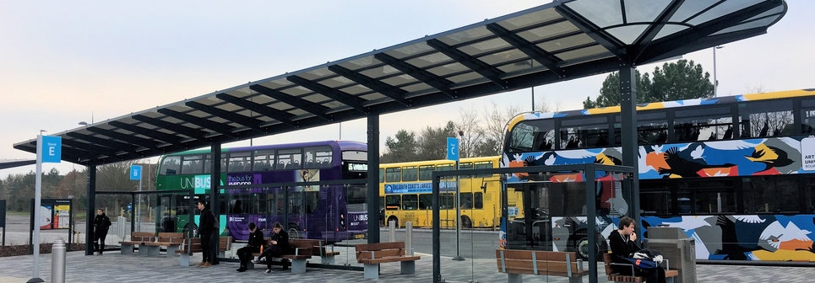
UTS Wide Hubs
What are Hubs?
Location where multiple routes stop and layover
Allow passengers to transfer between routes
Current UTS Hubs: Whitehead Rd and JPA @ UVA Hospital

Slide 9
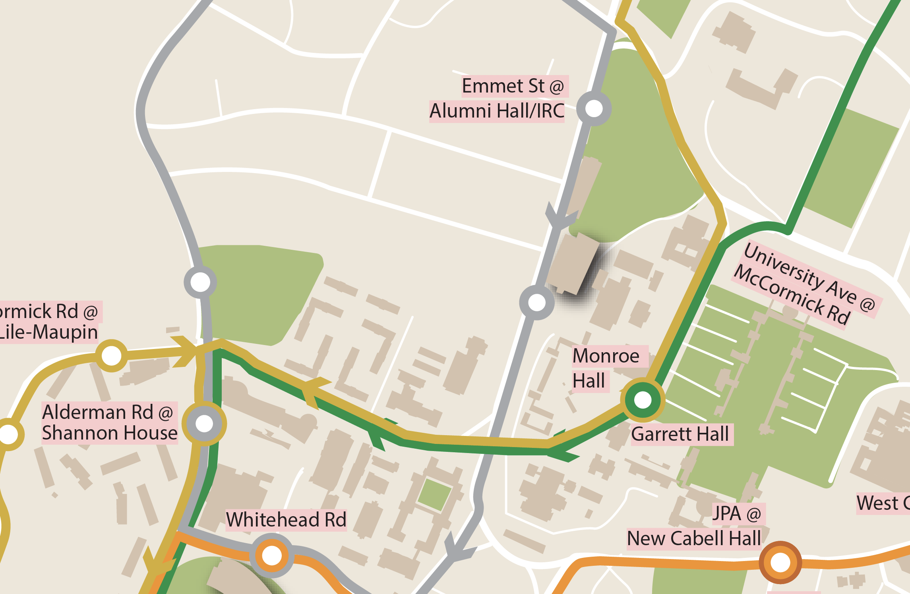
Concept: One Way vs. Two Way
One-Way
Two-Way
Reduces McCormick Footprint by 64%
Reduces McCormick Footprint by 27%
Notes:
One Way vs. Two Way: Ties into reducing the McCormick Rd footprint. 10 minute service → 12 Greens + 12 Golds each hour for bi-directional service vs 6 Greens + 6 Golds in Uni-directional service. One way traffic allows us to reduce our footprint by ~64%. Two-way traffic allows us to reduce footprint by ~27%. Recommendation for a one-way McCormick would be to travel from West to East (Trolley direction).

Slide 10
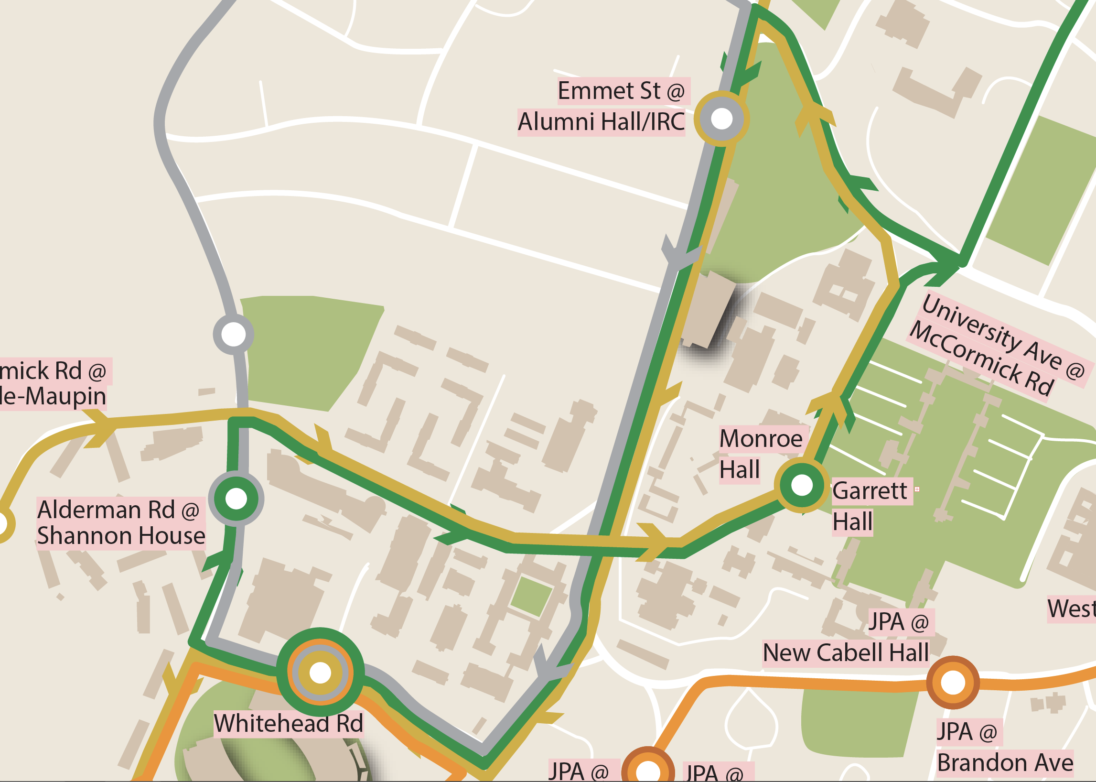
One Way, One Stop
Reduces the number of buses traveling on McCormick
Establishes Whitehead Rd as Academic Hub to provide transfer points
Notes:
Reduces the number of buses traveling on McCormick – by removing a direction, we decrease the number of buses traveling through the corridor by half
Additional Con: accessibility concerns for those with ADA needs, increased reliance on DART

Slide 11
Door #1: Fall 2021 if reduced capacity is still present

Slide 12
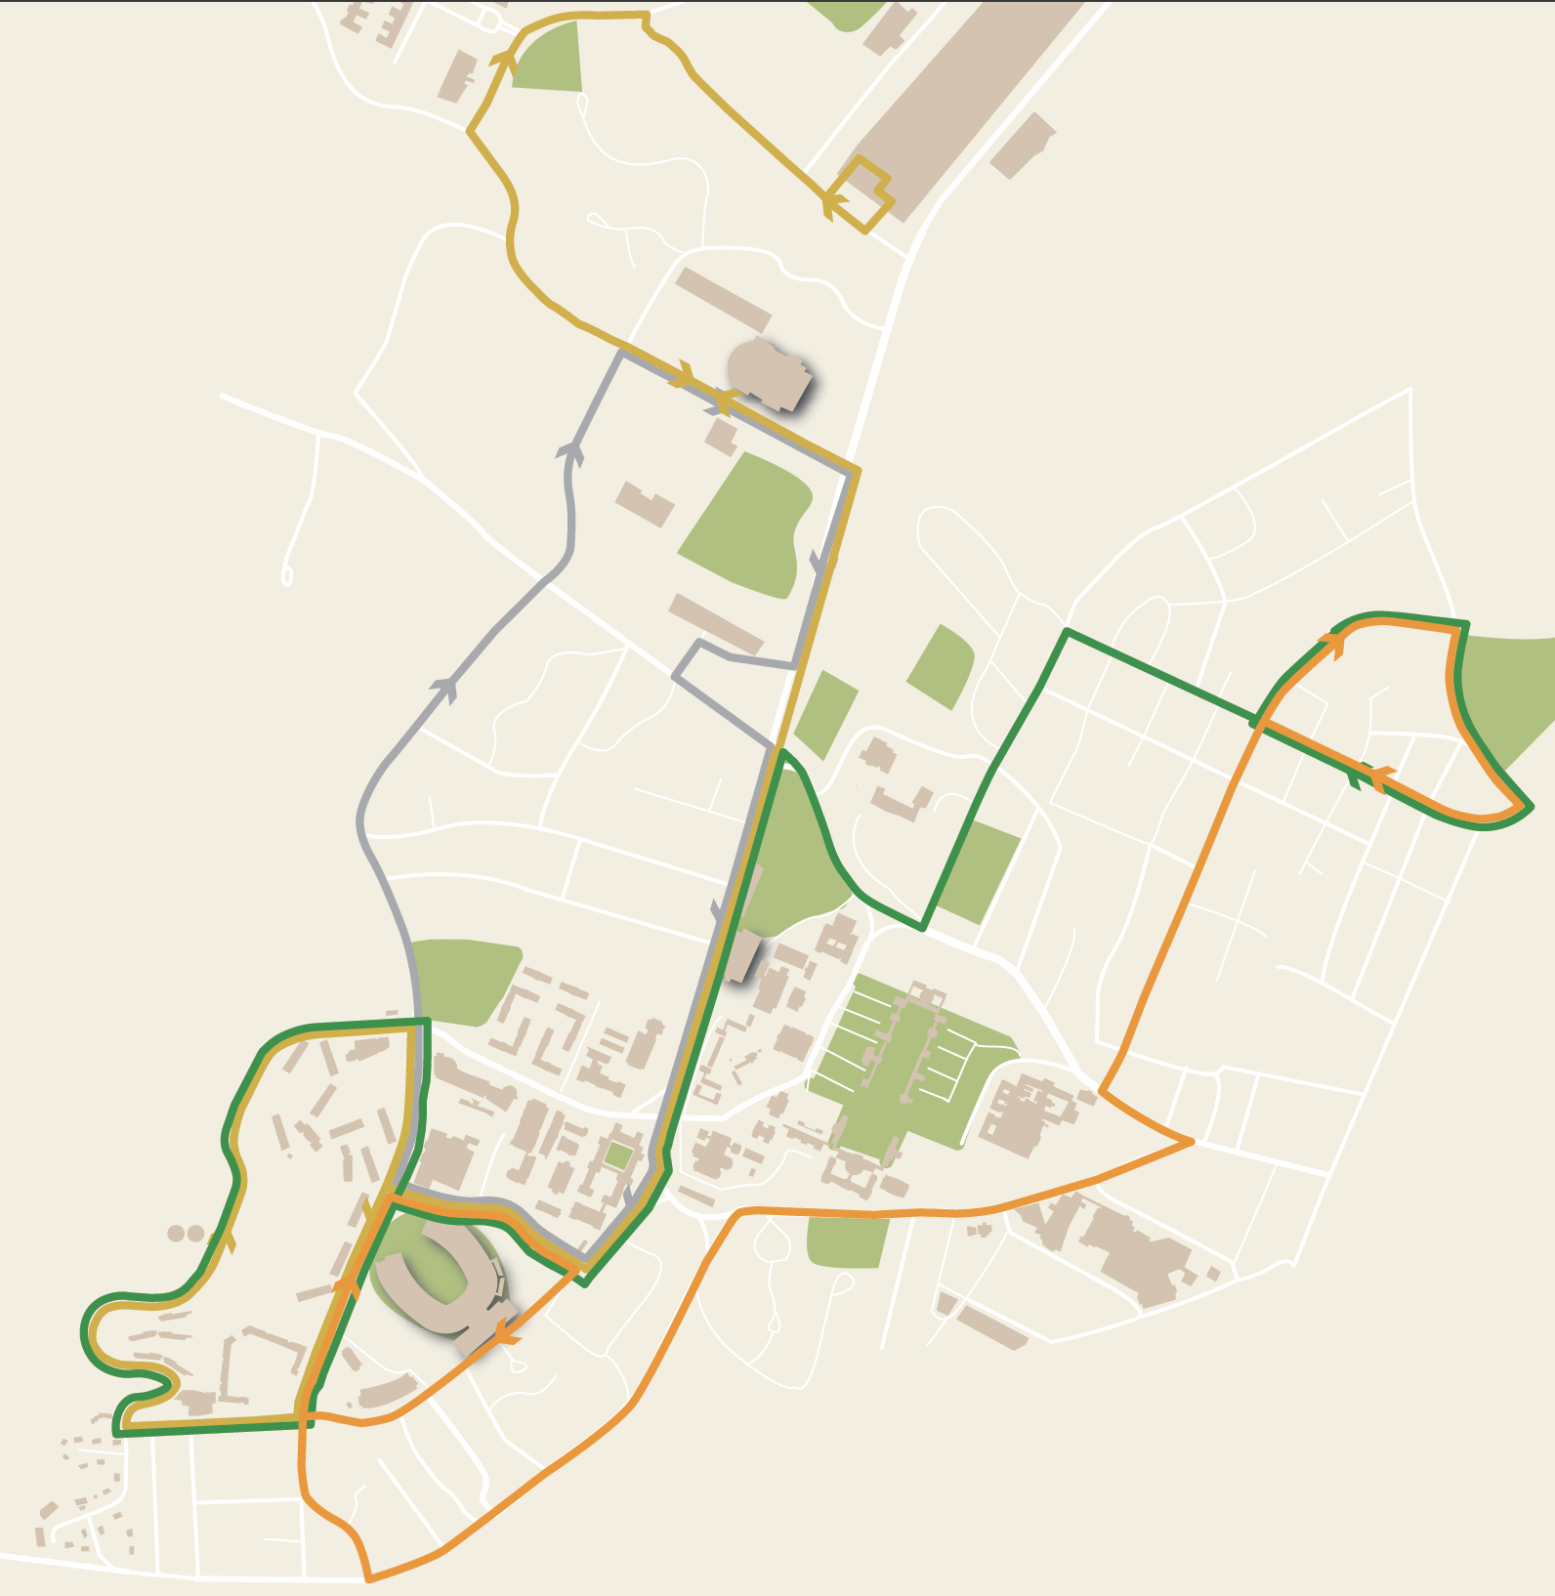
Notes:
Pros: the best option for eliminating our footprint, whitehead connectivity, least number of changes to current route structure, able to implement in Fall 2021 w/out concerns about capacity restrictions
Cons: no McCormick!

Slide 13
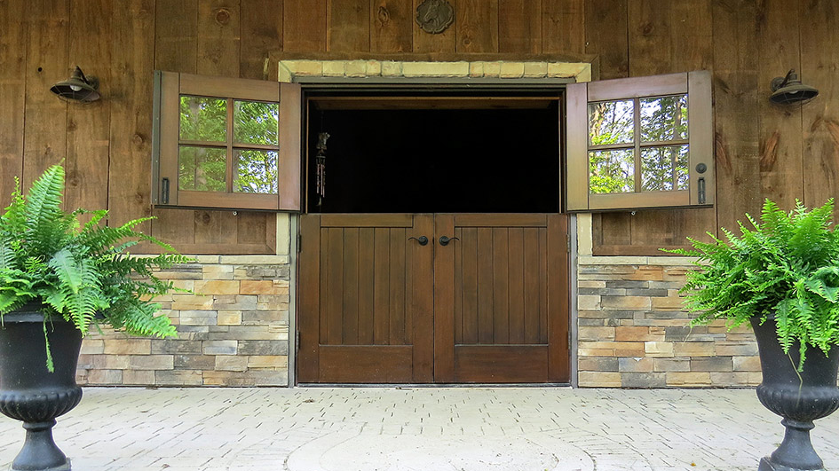
Door #4: Fall 2021 if passenger capacities are lifted

Slide 14
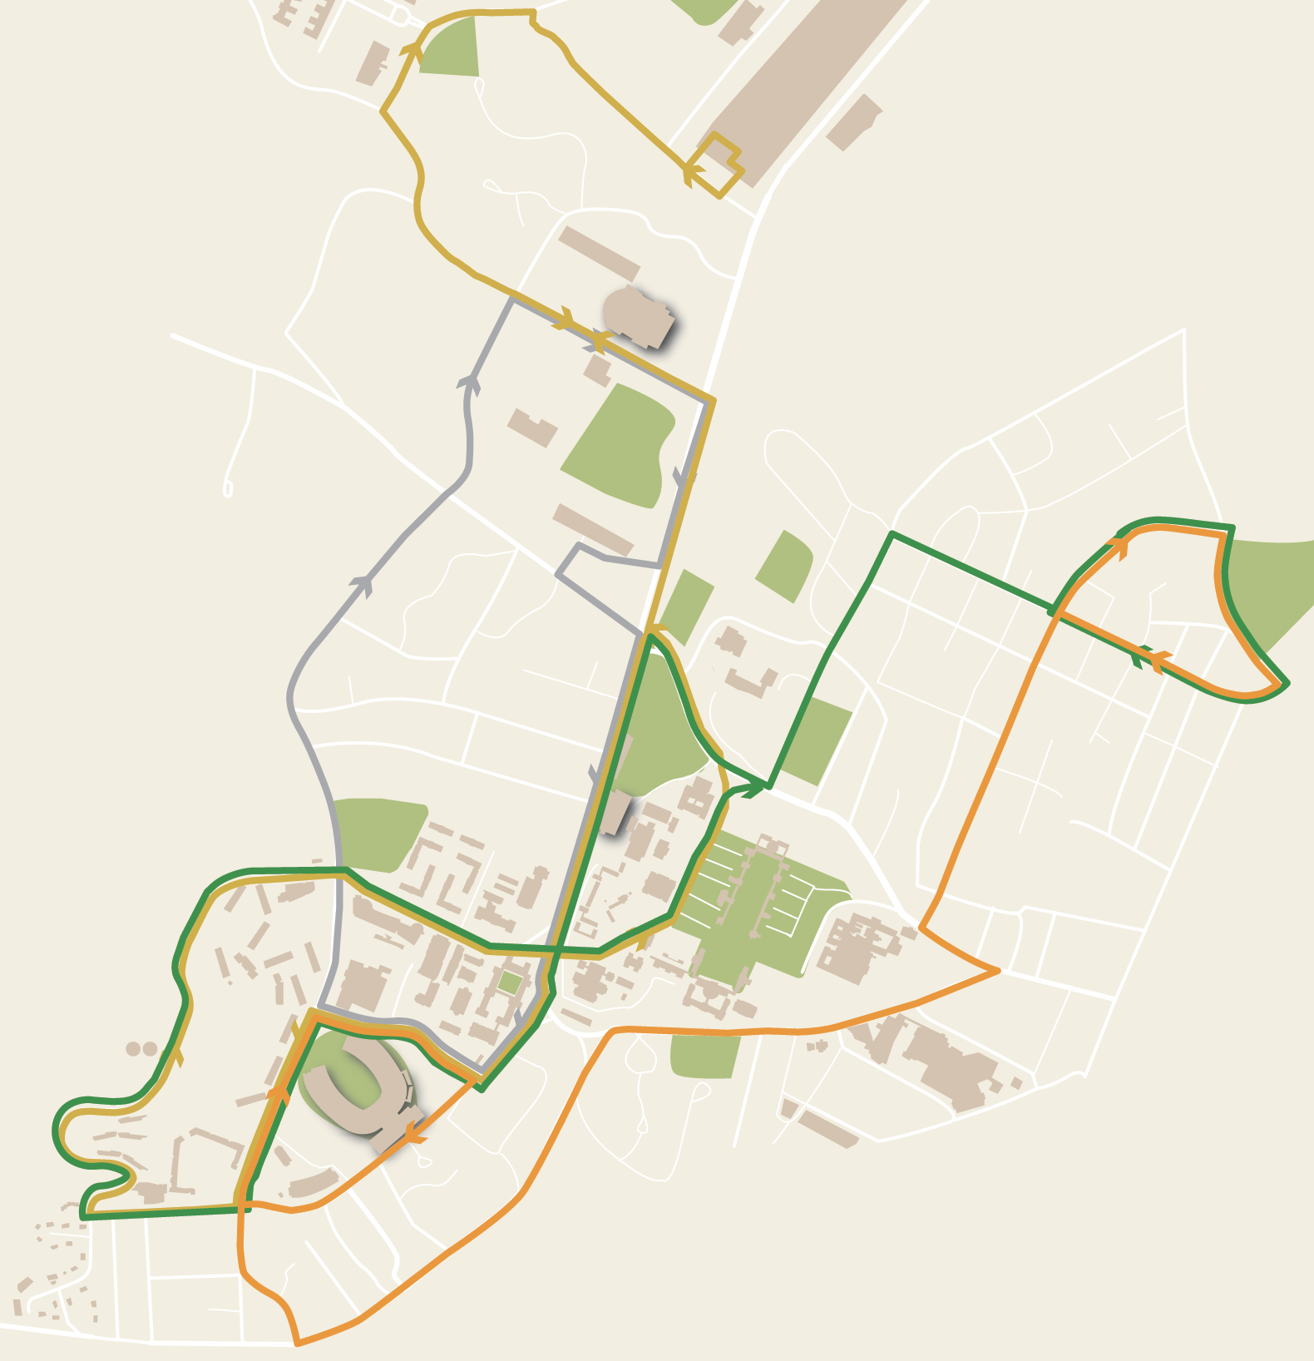
Notes:
Pros: good compromise between safety/reducing footprint and providing McCormick service, maintains connectivity of Whitehead, no left turn onto Northbound Emmet St, maintains southbound Emmet St service

Slide 15
Where UTS Once Was...
Focus on micromobility amenities at locations along McCormick that were previously served by UTS.
Bike Racks
Ensure there is enough bike parking with increased bike use likely
Rentable Bikes/Scooters
Work with vendor to target these areas for deployment/realignment
Moped Parking
Create additional moped parking for high demand areas
Chemistry Building, Garrett Hall, Chapel/Alderman Library

Slide 16
PATH FORWARD?

